Slide 1
SHRI MANEKLAL M.PATEL INSTITUTE OF
SCIENCE & RESEARCH
M.SC(INFORMATION TECHNOLOGY)
SEM-4
PROJECT REPORT: TASK BASE
COMPANY NAME : BINARY REPUBLIK PVT.LTD
LANGUAGE : .NET
STUDENT NAME: Kanzariya Foram A.
ENROLLMENT NO: 21MSCIT22004

Slide 2
INDEX
which is C# class and object
which is C# fibonacci series
which is C# abstract class
which is C# inheritance
which is C# polymorphism
Write a method that overloads the GetName() method by taking in a name and printing “Hello” with that name
Write a method that overloads the PerformAction() method with two arguments it could be numbers or strings.
If both arguments are number then it should return Sum of both numbers.
If both arguments are strings then it should return concate of both string with space as separator.
If there is no any arguments then it should print "Enter correct values“.
8. Registration form in Javascript with validation
9. Employee Details task with jQuery
10. Timesheet task with jQuery.

Slide 3
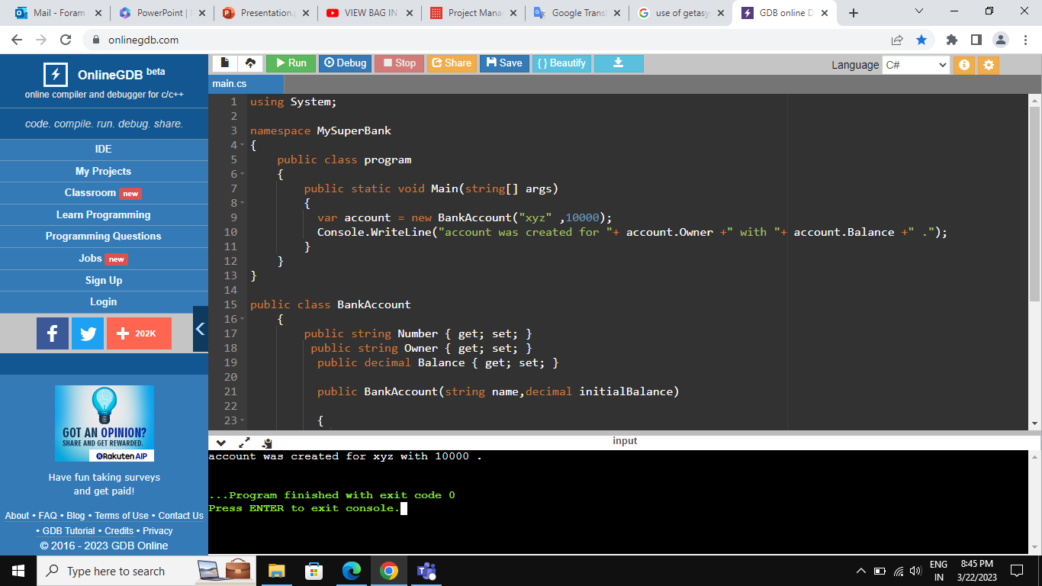
Task:1 which is C# class and object.

Slide 4
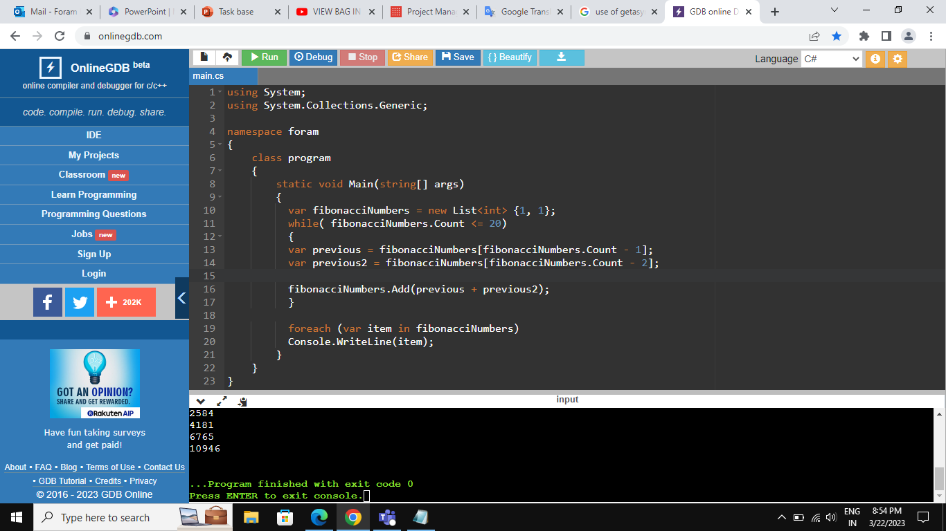
Task:2 which is C# fibonacci series.

Slide 5
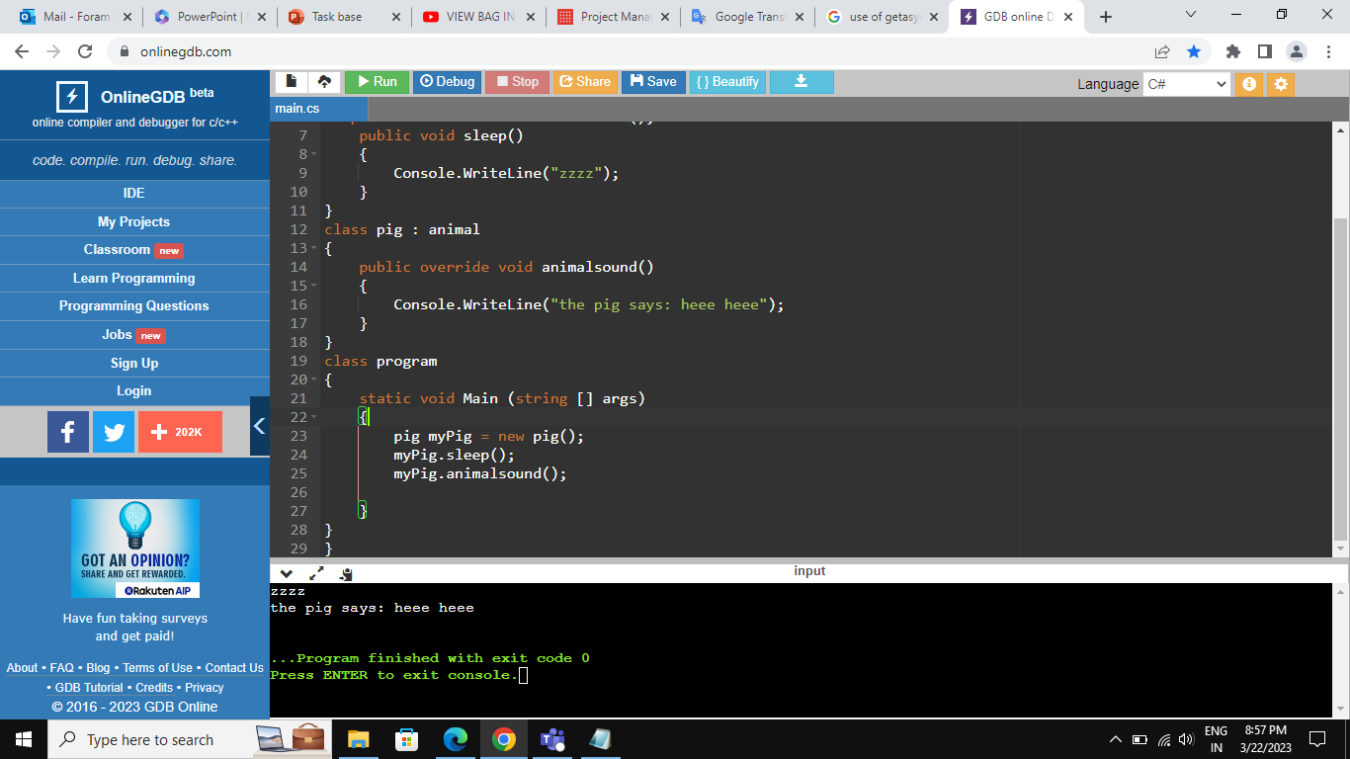
Task:3 which is C# abstract class.

Slide 6
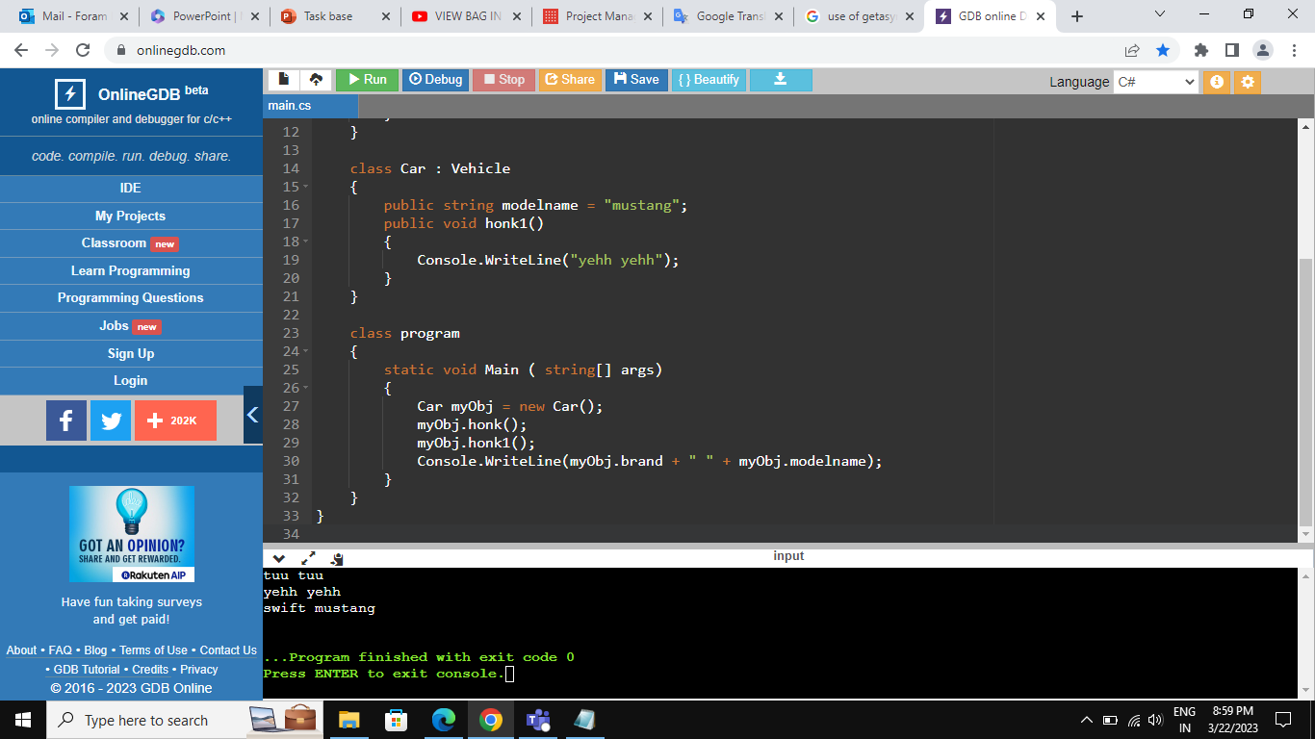
Task:4 which is C# inheritance.

Slide 7
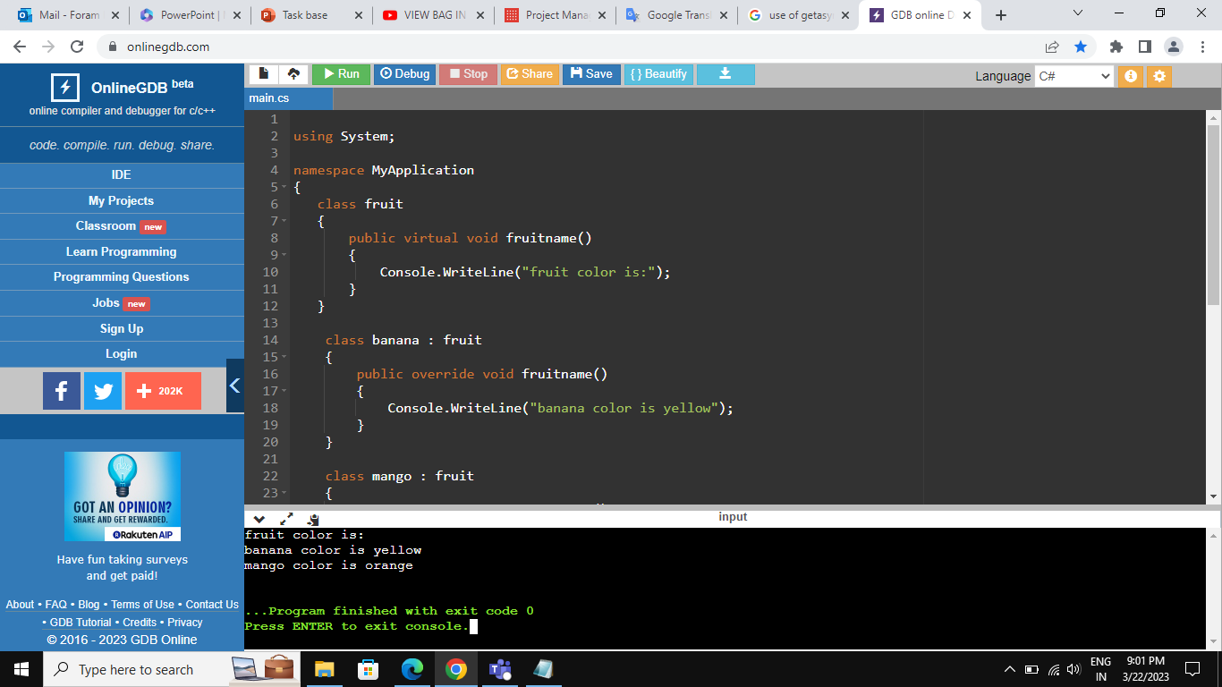
Task:5 which is C# polymorphism.

Slide 8
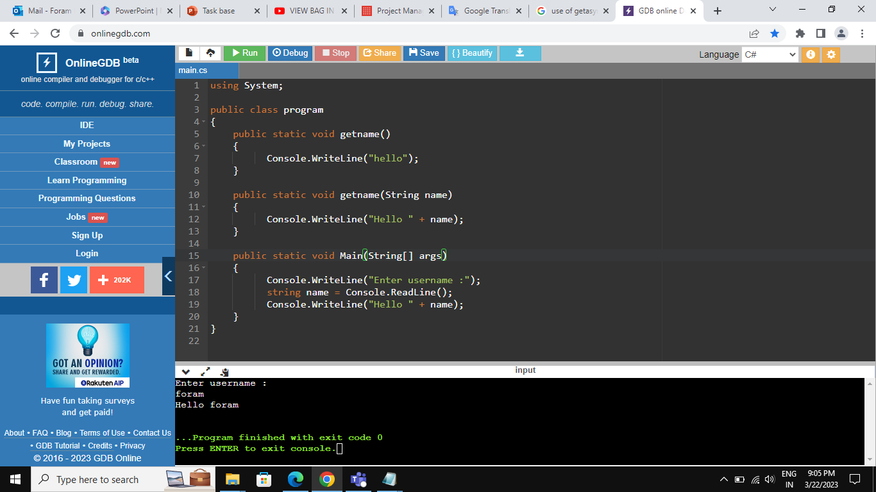
Task:6 Write a method that overloads the GetName() method by taking in a name and printing “Hello” with that name.

Slide 9
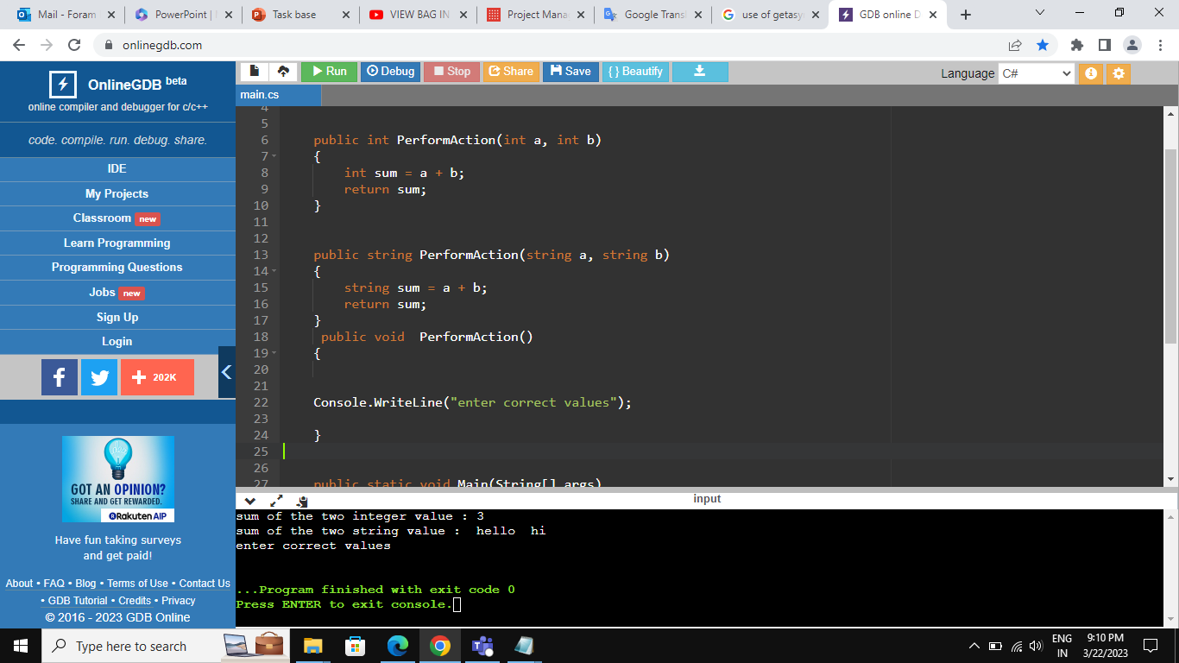
Task:7 Write a method that overloads the PerformAction() method with two arguments it could be numbers or strings.
If both arguments are number then it should return Sum of both numbers.
If both arguments are strings then it should return concate of both string with space as separator.
If there is no any arguments then it should print "Enter correct values".

Slide 10
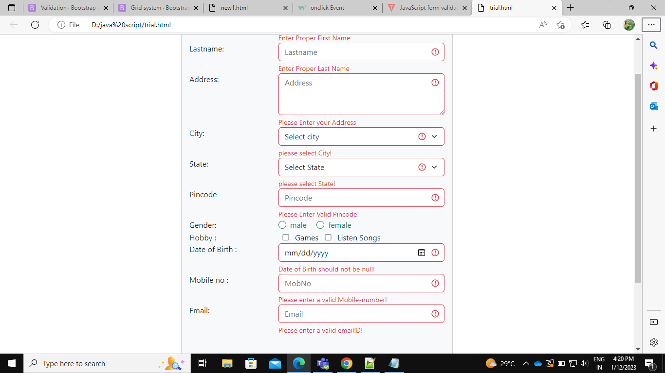
Task:8 Registration form in Javascript with validation.

Slide 11
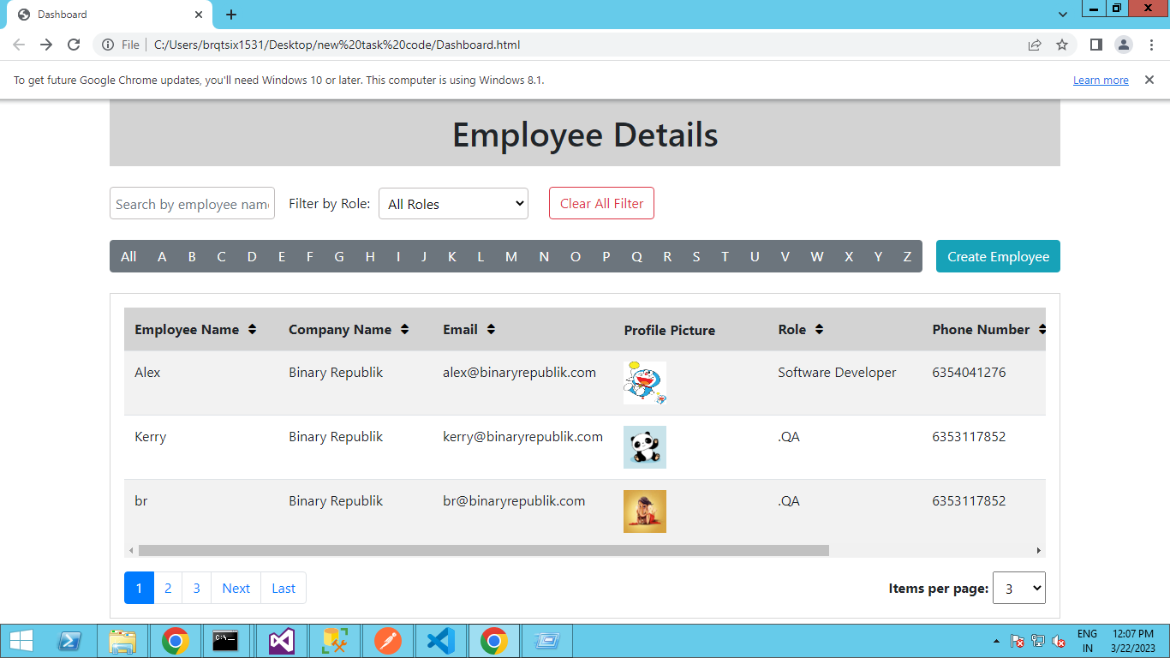
Task:9 Employee Details task with jQuery.

Slide 12
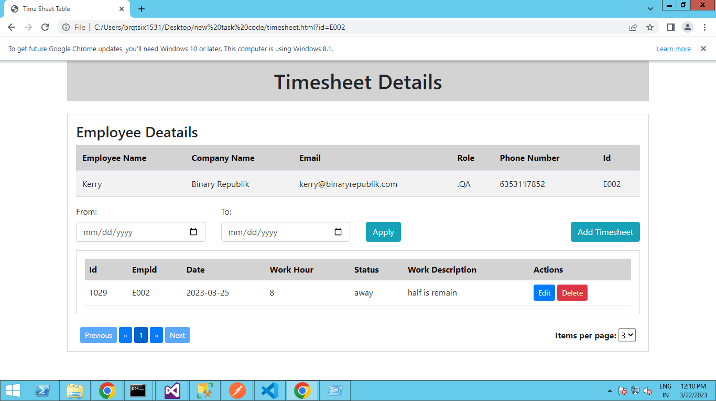
Task:10 Timesheet task with jQuery.

